Slide 1

GPUs
CS 161: Lecture 21
4/21/2021

Slide 2
Outline
Trends in Hardware Design
The GPU Programming Model
Types of GPUs
Case study: Intel’s Iris GPU

Slide 3
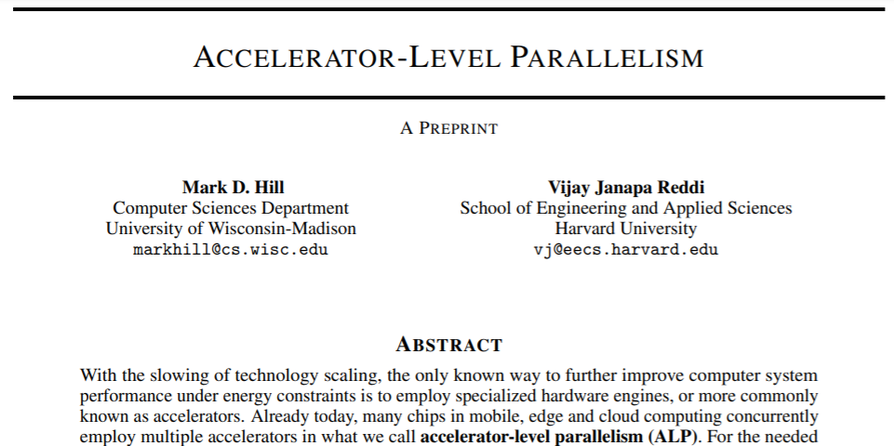
Trends in Hardware Design
Notes:
[Ref: “Accelerator-level Parallelism” by Hill and Reddi (https://arxiv.org/pdf/1907.02064.pdf)
https://www.eetasia.com/18083002-a-look-at-apples-vertical-integration/
]

Slide 4
Trends in Hardware Design
Bit-level parallelism: Increasing the size of instruction arguments (e.g., 32 bits → 64 bits)
Instruction-level parallelism: In a single thread, allow unrelated instructions to execute in parallel
Thread-level parallelism: Giving multiple cores to a single machine
Data-level parallelism: Concurrently performing the same operation on multiple pieces of data (e.g., GPUs!)
mov (%rax), %rbx
add %rbx, %rcx
sub %r9, %r10
Must be executed in order due to the data dependency
Can be executed before, after, or between the mov+add
Notes:
[Ref: “Accelerator-level Parallelism” by Hill and Reddi (https://arxiv.org/pdf/1907.02064.pdf)
https://www.eetasia.com/18083002-a-look-at-apples-vertical-integration/
]

Slide 5
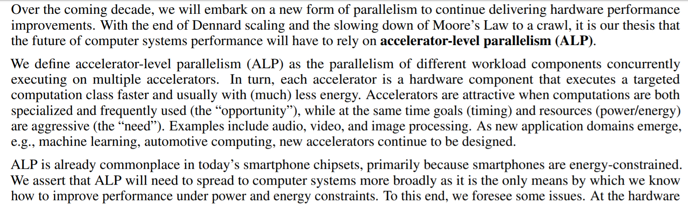
Notes:
[Ref: “Accelerator-level Parallelism” by Hill and Reddi (https://arxiv.org/pdf/1907.02064.pdf)]

Slide 6
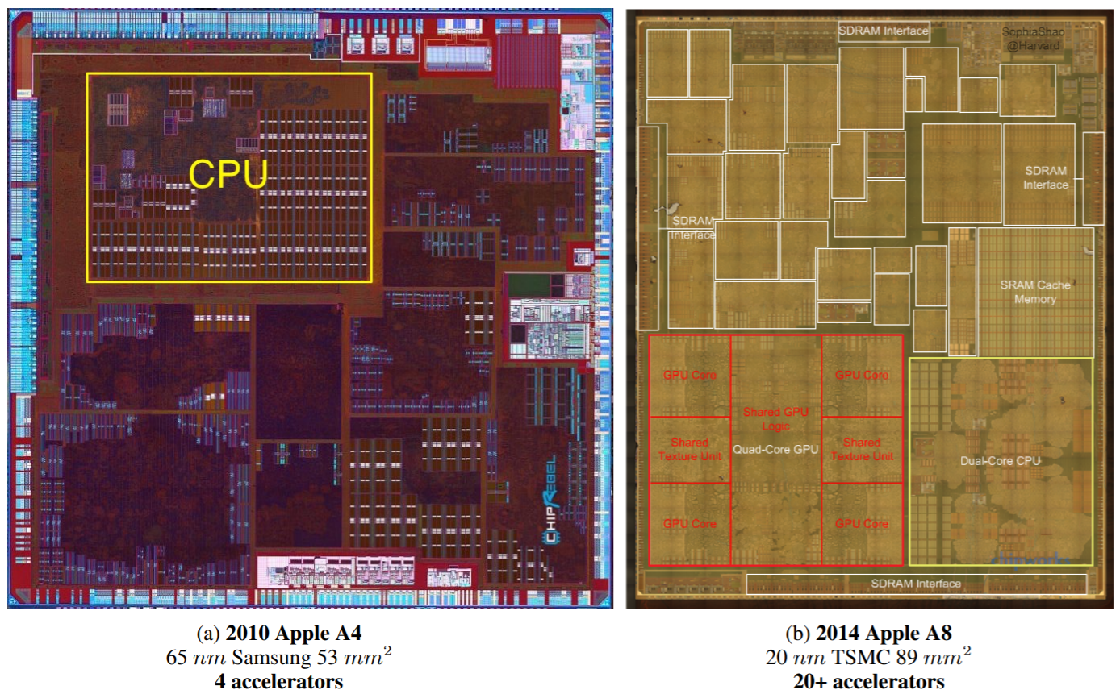
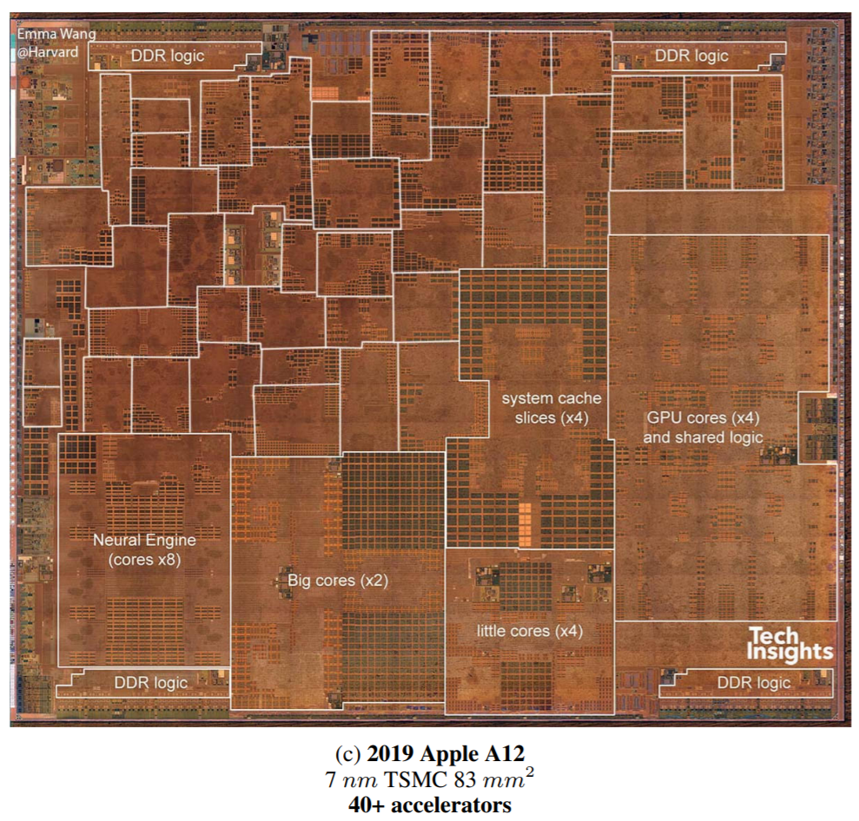
Integrated Design Is What Makes The iPhone Skinny!
Notes:
[Ref: “Accelerator-level Parallelism” by Hill and Reddi (https://arxiv.org/pdf/1907.02064.pdf)]

Slide 7

Steve Jobs in 2007, during the launch of the first iPhone
Helped to invent object-oriented programming and window-based GUIs!
Notes:
[Ref: https://www.youtube.com/watch?v=XAfTXYa36f4]

Slide 8
Outline
Trends in Hardware Design
The GPU Programming Model
Types of GPUs
Case study: Intel’s Iris GPU

Slide 9
GPUs: Overview
GPU hardware is specialized for highly-parallel, computationally-bound applications with simple control flows
ALU
ALU
Control
ALU
ALU
Cache
DRAM
DRAM
CPU
GPU
Doesn’t implement fancy stuff like out-of-order execution or branch prediction
Notes:
[Ref: https://www.usenix.org/system/files/conference/nsdi17/nsdi17-go.pdf //Section 2 (“Background”)
https://en.wikipedia.org/wiki/Single_instruction,_multiple_threads
]

Slide 10
GPUs: Overview
GPU hardware is specialized for highly-parallel, computationally-bound applications with simple control flows
The CPU offloads graphics computations to the GPU, and runs general-purpose code in parallel as the GPU works
ALU
ALU
Control
ALU
ALU
Cache
DRAM
DRAM
CPU
GPU
CPU
Launch GPU threads
Threads complete
Launch GPU threads
Threads complete
GPU
Notes:
[Ref: https://www.usenix.org/system/files/conference/nsdi17/nsdi17-go.pdf //Section 2 (“Background”)
https://en.wikipedia.org/wiki/Single_instruction,_multiple_threads
]

Slide 11
Maximizing Parallelization: SIMD vs. SIMT
SIMD (“single instruction, multiple data”) increases the number of calculations that are performed by one instruction
Starting in 2006, Intel has added a variety of SIMD instructions to accelerate scientific, multimedia, and cryptographic workloads
%xmm0—%xmm15 are 128-bit registers for use by SIMD instructions
An %xmm register is treated differently by different SIMD instructions, e.g., as
Two 64-bit floats
Four 32-bit floats
Eight 16-bit shorts
Sixteen 8-bit bytes
Example: vector addition
//C code
vec_out.w = v1.w + v2.w;
vec_out.x = v1.x + v2.x;
vec_out.y = v1.y + v2.y;
vec_out.z = v1.z + v2.z;
movaps (v1), %xmm0 //%xmm0 = v1.z | v1.y |
// v1.x | v1.w
addps (v2), %xmm0 //%xmm0 = v1.z+v2.z |
// v1.y+v2.y |
// v1.x+v2.x |
// v1.w+v2.w
movaps %xmm0, (vec_out)
Notes:
`movaps` stands for “move aligned packed single precision” floating-point values. `addps` stands for “add packed single precision” floating-point values.
[Ref: https://en.wikipedia.org/wiki/Streaming_SIMD_Extensions
https://www.felixcloutier.com/x86/movaps
https://www.felixcloutier.com/x86/addps
]

Slide 12
Maximizing Parallelization: SIMD vs. SIMT
SIMD (“single instruction, multiple data”) increases the number of calculations that are performed by one instruction
SIMT (“single instruction, multiple threads”) is used by GPUs to increase parallelism
Thread: A sequence of scalar (i.e., non-SIMD) instructions
Block: A group of multiple threads where each thread:
Contains the same instruction sequence
Has separate registers and local variables!
Runs on the same streaming multiprocessor (SM)
Knows its thread id and block id
Grid: A collection of blocks that belong to the same computational “kernel”
Warp: A subset of threads in a block (32 on Nvidia GPUs) that simultaneously execute on the same SM
Structure of a kernel
Thread instructions
Thread
instr₀
instr₁
Block
instr₂
instr₃
instr₄
Grid
Notes:
In the context of GPU programming, a “kernel” refers to a set of mathematical operations to perform—not to an OS kernel!
Note that the grid layout is a convenient abstraction for graphics problems, since you can divide the screen into a grid, and then assign different threads to render different parts of the screen in parallel. The grid layout is also a convenient abstraction for many kinds of problems in machine learning, where training a model can be decomposed into a bunch of parallel tasks.
[Ref: https://nyu-cds.github.io/python-gpu/02-cuda/
https://en.wikipedia.org/wiki/Thread_block_(CUDA_programming)
https://en.wikipedia.org/wiki/Thread_block_(CUDA_programming)#Warps
]

Slide 13


SM scheduler logic
Inside a streaming multiprocessor
Warp queue
Warp2
Warp0
Warp7
Fetch
Structure of a kernel
Registers
Thread instructions
Decode
Thread
instr₀
instr₁
Warp0
Warp1
Block
instr₂
D-Cache
instr₃
At least one thread misses
All threads hit in D-cache
instr₄
Warp1
Grid
Warp3
All data arrives
Writeback
Notes:
Note that all of the threads in a warp have to exit the pipeline at the same time—this is why the threads are said to be in a warp. However, suppose that, while going through the D-cache stage, one or more threads suffer from a miss; in other words, one or more threads has to block until data can be fetched from RAM and pulled into the D-cache. If this happens, then the SM has to suspend the *entire* warp, only resuming the warp when all of the D-cache results have arrived. [As http://www.cs.fsu.edu/~yuw/pubs/2015-ICS-Yu.pdf states:
“Within the lock-step execution model, a warp becomes ready when all of its demanded data is available; warps that have missing data, regardless of the data size, are excluded for execution. This execution model of GPU expects that all cache blocks of each divergent load instruction are cached as a unit when there is locality. However, conventional cache management is unaware of the GPU execution model and the collective nature of divergent memory blocks. As a result, some blocks of a divergent instruction can be evicted while others are still cached, resulting in a varying number of cache misses for individual loads.”]
When a particular warp is suspended, the SM can execute other warps.
Note that, in this SM, the execute stage has enough ALUs to execute every instruction in a warp in parallel! [In a real-life SM, there may not be enough ALUs so that each thread in a warp gets a dedicated one—see the Intel Iris architecture discussed later in the slide deck.]
[Ref: https://www.archive.ece.cmu.edu/~ece740/f13/lib/exe/fetch.php?media=onur-740-fall13-module5.1.3-simd-and-gpus-part3-vliw-dae-systolic.pdf //Saved as gpu-arch2.pdf]

Slide 14
SM scheduler logic
Inside a streaming multiprocessor
Warp queue
Warp2
Warp0
Warp7
Fetch
This part is similar to a traditional SIMD pipeline
However, there are multiple threads executing the same instruction on different inputs, not one instruction operating on multiple inputs
In SIMT, what happens if . . .
The instruction to execute is a branch, and
Different threads evaluate the branch condition differently?
Registers
Decode
D-Cache
At least one thread misses
Warp1
All threads hit in D-cache
Warp3
All data arrives
Writeback

Slide 15

There Is A (Janky) Solution!
UGGGGGHGHHHHHHHHHHGHGHKJ
All threads in a warp execute the branch test at the same time
The “test succeeds” threads then execute the if-path while the other threads in the warp are idle
Afterwards, the “test fails” threads execute the else-path while the other threads in the warp are idle
So, the two execution paths execute serially!
in[] = {4,8,12}; //1D
//global input array
0: i = in[threadIdx.x];
//Thread offset in
//the 1D input data
1: if(i < 10)
2: r = 0;
else
3: r = 1;
4: out[threadIdx.x] = r;
SM execution of the warp
0
T0
T1
T2
1
T0
T1
T2
2
T0
T1
T2
3
T0
T1
T2
4
T0
T1
T2
Notes:
Note that the “number:” stuff wouldn’t appear in the actual source code: those annotations just provide line numbers for the example. Also note that, in this example, `in` and `out` are global variables that are visible to all threads; in contrast, `i` and `r` are thread-local variables.
[Ref: https://cvw.cac.cornell.edu/GPU/thread_div
https://www.cis.upenn.edu/~devietti/classes/cis601-spring2016/hipeac-2015.updated.pdf //Slide 20, which
//is the basis for the example above
https://devblogs.nvidia.com/easy-introduction-cuda-c-and-c/
https://cs.calvin.edu/courses/cs/374/CUDA/CUDA-Thread-Indexing-Cheatsheet.pdf
]

Slide 16
Thread-Accessible Memory (Nvidia-style External GPU)
Global memory
Visible to all threads in the application
Persists for as long as the application runs
Local memory
Only visible to a thread
Only persists for the lifetime of the thread
Bytes are actually stored in global memory!
Shared memory
Visible to all threads in a block
Only persists for the lifetime of the block
Bytes typically live in per-SM RAM (e.g., 64 KB)
Allows threads in the block to communicate with each other
Developers annotate variables (e.g., as __shared__) and the compiler (e.g., the CUDA compiler for Nvidia GPUs) is responsible for generating the right kind of memory accesses to variables
GPU
Global memory
Fetch
Fetch
Decode
Decode
Shared memory
Shared memory
D-Cache
D-Cache
Writeback
Writeback
SM
SM
Notes:
[As described by [5], “Global memory is a 49-bit virtual address space that [is] visible to all threads in the GPU . . . Local memory is private storage for an executing thread and is not visible outside of that thread. It is intended for thread-local data like thread stacks and register spills. Local memory addresses are translated to global virtual addresses . . . Local memory has the same latency as global memory . . . Shared memory is located on chip, so it has much higher bandwidth and much lower latency than either local or global memory.”]
[Nvidia uses the term “CUDA core” to refer to an SM.]
[Ref: [1] https://jhui.github.io/2017/03/06/CUDA/
[2] https://www.microway.com/hpc-tech-tips/gpu-memory-types-performance-comparison/
[3] https://developer.download.nvidia.com/CUDA/training/register_spilling.pdf
[4] https://www.cis.upenn.edu/~devietti/classes/cis601-spring2016/hipeac-2015.updated.pdf //gpu-arch3.pdf;
//see slides 29, 30, and 38.
[5] https://docs.nvidia.com/nsight-compute/ProfilingGuide/index.html
]

Slide 17

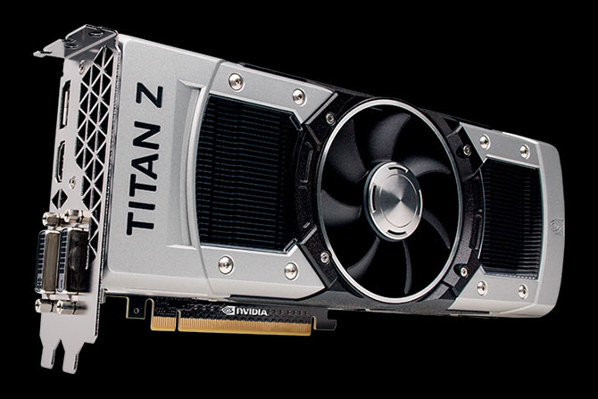
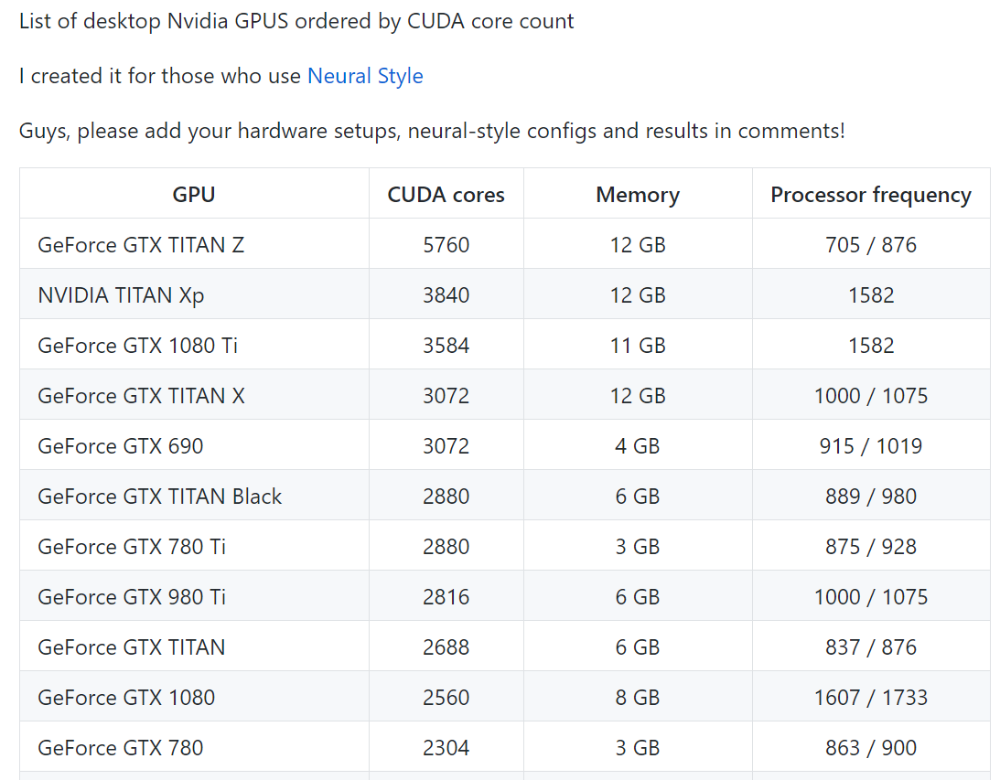
PCIe v3.0 x16: 32 GB/s
A single CUDA core has a warp width in the dozens (e.g., 32)!
Notes:
The Titan is sold out at traditional outlets like Amazon and NewEgg. Now the only places to get it are from resellers.
Note that modern Nvidia GPUs have a warp width of 32 threads.
[Ref: https://gist.github.com/cavinsmith/ed92fee35d44ef91e09eaa8775e3284e
https://en.wikipedia.org/wiki/PCI_Express#History_and_revisions //Provides PCIe bandwidths. Remember that
//a PCIe lane is a full-duplex connection. So, the 32 GB/s of PCIe v3.0 x16 lanes means
//16 GB/s in both directions.
https://www.pcgamer.com/nvidia-geforce-rtx-2070-super-review/
]

Slide 18
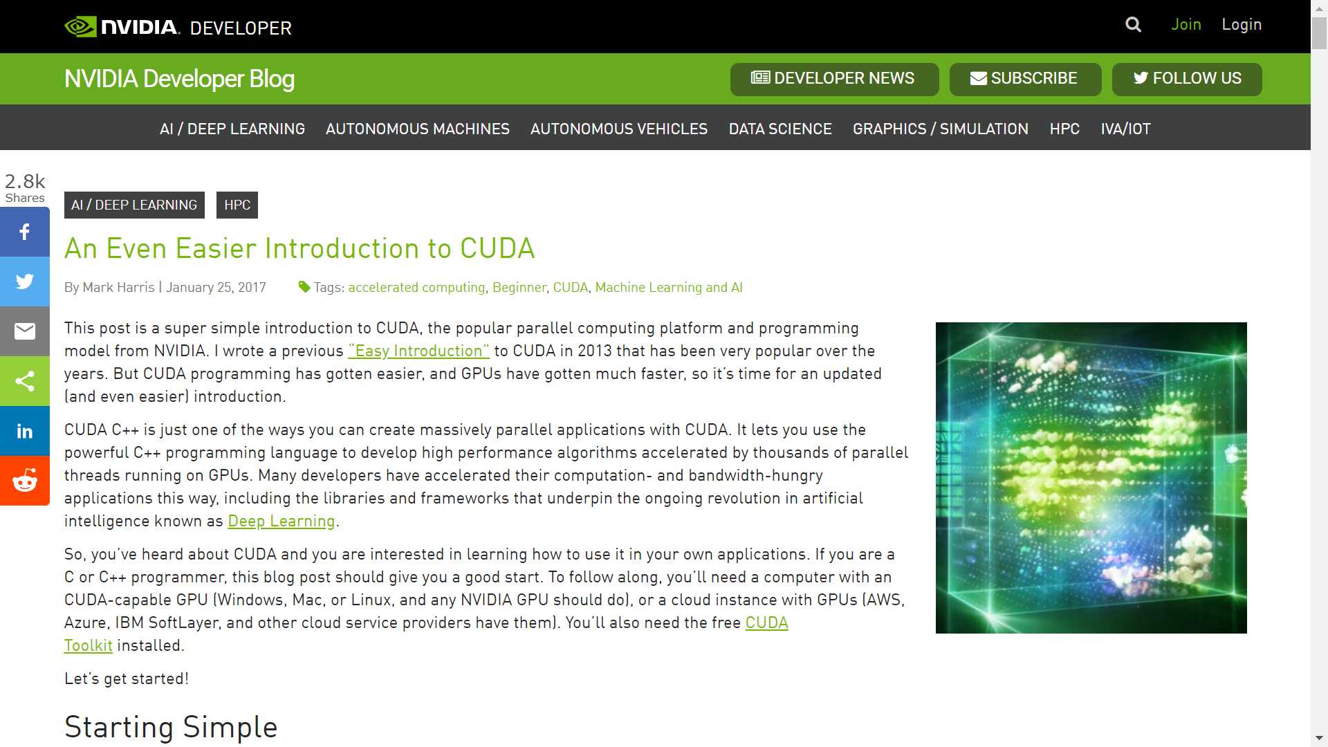
Notes:
[Ref: https://devblogs.nvidia.com/even-easier-introduction-cuda/]

Slide 19
Goal: Do a Vector-Addition of Two Large Arrays

Slide 20
Version 1: Regular C++ Code
//Vector-add two arrays.
void add(int n, float *x, float *y){
for (int i = 0; i < n; i++)
y[i] = x[i] + y[i];
}
int main(){
int N = 1<<20; // 1M elements
float *x = new float[N];
float *y = new float[N];
//Initialize the arrays.
for (int i = 0; i < N; i++) {
x[i] = 1.0f;
y[i] = 2.0f;
}
//Run kernel.
add(N, x, y);
delete [] x;
delete [] y;
return 0;
}

Slide 21
Version 2: CUDA (1 block with 256 threads)
//Vector-add two arrays.
__global__ //Tells CUDA that add()
//is a kernel that runs
//on a GPU, and can be
//called by a CPU.
void add(int n, float *x, float *y){
int index = threadIdx.x; //Index of the
//current thread in the 1D block.
int stride = blockDim.x; //Total number
//of threads in the 1D block.
for (int i = index; i < n; i += stride)
y[i] = x[i] + y[i];
}
int main(){
int N = 1<<20; // 1M elements
//Allocate "unified memory" that's
//accessible from both CPU and GPU.
float *x, *y;
cudaMallocManaged(&x, N*sizeof(float));
cudaMallocManaged(&y, N*sizeof(float));
//Initialize the arrays.
for (int i = 0; i < N; i++) {
x[i] = 1.0f; y[i] = 2.0f;
}
//Run kernel (1 block and 256 threads)
add<<<1, 256>>>(N, x, y);
//Wait for GPU to finish.
cudaDeviceSynchronize();
cudaFree(x); cudaFree(y); return 0;
}
Thread
One-dimensional block

Slide 22
Version 3: CUDA (4096 blocks, each with 256 threads)
//Vector-add two arrays.
__global__ //Tells CUDA that add()
//is a kernel that runs
//on GPU, and can be
//called by CPU.
void add(int n, float *x, float *y){
int index = (blockIdx.x * blockDim.x) +
threadIdx.x;
//(myBlockId * threadsInBlock) +
//(myThreadIdInBlock)
int stride = blockDim.x * gridDim.x;
//threadsInBlock * blocksInGrid
for (int i = index; i < n; i += stride)
y[i] = x[i] + y[i];
}
int main(){
int N = 1<<20; // 1M elements
//Allocate "unified memory" that's
//accessible from both CPU and GPU.
float *x, *y;
cudaMallocManaged(&x, N*sizeof(float));
cudaMallocManaged(&y, N*sizeof(float));
//Initialize the arrays.
for (int i = 0; i < N; i++) {
x[i] = 1.0f; y[i] = 2.0f;
}
//Run kernel (4096 blocks, 256 threads
//each)
add<<<4096, 256>>>(N, x, y);
//Wait for GPU to finish.
cudaDeviceSynchronize();
cudaFree(x); cudaFree(y); return 0;
}
Thread
Block
One-dimensional grid

Slide 23
Performance Results (Laptop GeForce GT 750M)
Version 1 (regular C++ code): Hundreds of milliseconds
Version 2 (CUDA: 1 block, 256 threads per block): 3.2 ms
Version 3 (CUDA: 4096 blocks, 256 threads per block): 0.68 ms

Slide 24
Outline
Trends in Hardware Design
The GPU programming model
Types of GPUs
Case study: Intel’s Iris GPU

Slide 25



Memory-mapped PCI-e Devices
10 Gbps
PCI-e NIC
CPU package
Each PCI-e device is bound to a range of memory addresses that are managed by the device (not by actual RAM)
x4
SDRAM
Root complex
Root complex
SDRAM
DMI
PCH
DMI
x4
PCI-e
port 1
(x8)
PCI-e
port 2
(x16)
PCI-e
port 3
(x16)
PCI-e
port 1
(x8)
PCI-e
port 2
(x16)
PCI-e
port 3
(x16)
RAM
RAM
PCI-e
switch
PCI-e
switch
PCI-e
switch
PCI-e
switch
The root complex translates between CPU-created memory requests and PCI-e messages
The CPU writes to device-owned memory addresses to send commands or configure the device
A device sends a PCI-e message to the root complex to respond to a request or proactively interrupt the CPU
x8
x16
x16
x16
x16
x8
x16
x16
x16
x16
Slot1
Slot2
Slot3
Slot4
Slot5
Slot6
Slot11
Slot10
Slot9
Slot8
Slot7
Microway’s Octoputer
(optimized for 8 GPUs)
Notes:
Note that the Octoputer has oversubscription along its PCI-e links. Oversubscription means that all devices cannot simultaneously exchange data with a CPU at full speed. For example, each of the x16 lanes coming out of a CPU are two-way oversubscripted, because each of those x16 lanes connect to a switch which talks to TWO devices, each of which has x16 lanes. Oversubscription won’t be noticed if both of those devices are rarely active at the same time.
DMI (Direct Media Interface) is just another bus protocol. At a high level, DMI is similar to PCI-e: DMI uses lanes, differential signaling, and point-to-point connections between devices.

Slide 26
Integrated vs Discrete GPUs
An integrated GPU:
Lives on the same package that contains the CPUs
Communicates with the CPUs via an on-chip bus (e.g., an AGP, PCI-e, or proprietary bus that connects directly to a root complex)
A discrete GPU:
Is a separate piece of silicon
Communicates with the CPUs via an external bus (e.g., PCI-e lanes which connect to CPUs via a root complex)
Integrated GPUs:
Require less space and consume less energy (due to co-design with the rest of the chip)
Are financially cheaper
Have worse compute performance—a discrete GPU has more space for more compute elements, and often has its own RAM and caching hierarchy
Can access host RAM directly, avoiding copies between host RAM and GPU RAM

Slide 27
Outline
Trends in Hardware Design
The GPU programming model
Types of GPUs
Case study: Intel’s Iris GPU

Slide 28
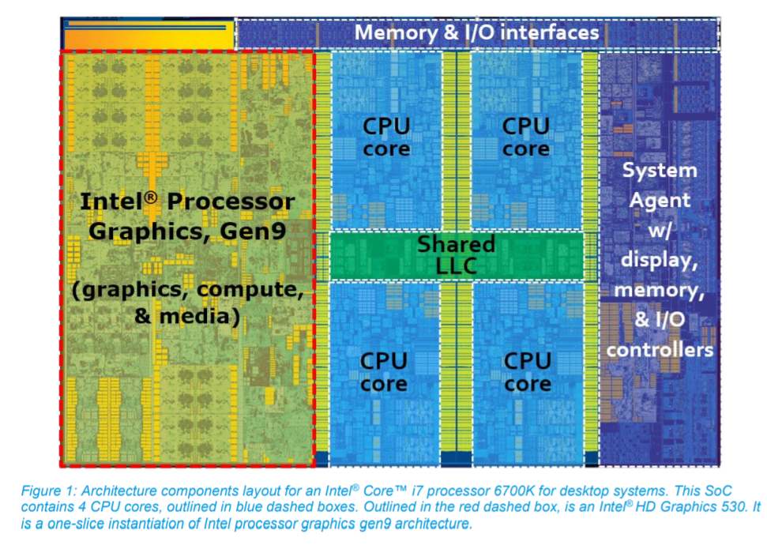
Case Study: Intel’s Iris Integrated GPU
Notes:
[Ref: https://software.intel.com/sites/default/files/managed/c5/9a/The-Compute-Architecture-of-Intel-Processor-Graphics-Gen9-v1d0.pdf]

Slide 29

Case Study: Intel’s Iris Integrated GPU
L1-i
L3 cache shard
L2
SDRAM
L1-d
Root complex
Ring bus
(proprietary protocol)
PCI-e lanes
(xWhatever)
RAM
L3 cache shard
L1-i
L2
L1-d
PCI-e device
“System on a Chip”
(SoC)
Notes:
The Iris is not a smartphone GPU—instead, it’s intended for laptops and desktops.
As described by Intel, in a SoC, “each on-die core is allocated a slice of cache, and that cache slice is connected as a unique agent on the ring. However, all of the slices work together as a single cache, albeit a shared and distributed cache. An address hashing scheme routes data requests to the cache slice assigned to its address. This distributed LLC is also shared with Intel processor graphics. For both CPU cores and for Intel processor graphics, LLC seeks to reduce apparent latency to system DRAM and to provide higher effective bandwidth.”
[Ref: See https://github.com/Igalia/intel-osrc-gfx-prm/tree/master/011_kbl_-_2016-2017 for the chapters in the Iris Programmer’s Reference Manual.
Also see Figure 2 of https://software.intel.com/sites/default/files/managed/c5/9a/The-Compute-Architecture-of-Intel-Processor-Graphics-Gen9-v1d0.pdf
See https://software.intel.com/sites/default/files/managed/db/88/The-Architecture-of-Intel-Processor-Graphics-Gen11_R1new.pdf; Figure 7 is
particularly relevant for the diagram above, since it depicts each core’s private L1 and L2 caches.
https://www.anandtech.com/show/3922/intels-sandy-bridge-architecture-exposed/4
]

Slide 30
Case Study: Intel’s Iris Integrated GPU
L1-i
L3 cache shard
L2
SDRAM
L1-d
Root complex
Ring bus
(proprietary protocol)
PCI-e lanes
(xWhatever)
RAM
L3 cache shard
L1-i
L2
L1-d
PCI-e device
CPU sends commands to GPU (via MMIO registers), and GPU sends interrupts to CPU, via the ring, without leaving the SoC!
“System on a Chip”
(SoC)

Slide 31
Case Study: Intel’s Iris Integrated GPU
L1-i
L3 cache shard
L2
SDRAM
L1-d
Root complex
Ring bus
(proprietary protocol)
PCI-e lanes
(xWhatever)
RAM
L3 cache shard
L1-i
L2
L1-d
PCI-e device
GPU can access host RAM directly, without having to copy graphics buffers between on-GPU RAM and host RAM!
“System on a Chip”
(SoC)

Slide 32
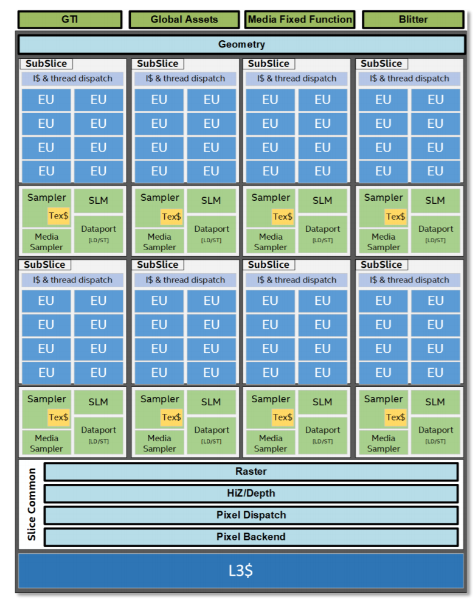
An EU (“Execution Unit”) is an SM
Each EU simultaneously runs instructions from four threads
Each SIMD ALU in an EU can issue:
Four 32-bit operations per cycle, or
Eight 16-bit operations per cycle
Each sub-slice contains:
Eight EUs
A scheduler which assigns warps to EUs
SLM (“Shared Local Memory”): 64 KB
The GPU has:
Eight sub-slices (and thus 64 total EUs)
A private L1/L2/L3 cache
Global thread memory lives in normal system RAM, and the GPU shares the normal L3 cache with the CPUs
GTI (“Graphics Technology Interface”) is the bus interface that connects the GPU to the rest of the SoC
Notes:
The GPU has a private L1/L2/L3 caching layer. The GPU also shares the “normal” L3 cache with the CPUs on the SOC. So, from the perspective of the GPU, the “normal” L3 cache is like an L4 cache that sits in front of the GPU’s private L1/L2/L3 cache.

Slide 33
Summary
SM scheduler logic
Warp queue
Challenges in semiconductor physics mean that future performance gains will likely require specialized hardware accelerators
GPUs accelerate highly-parallel, compute-bound workloads
SM (“streaming multiprocessors”) execute the same instruction from multiple threads on different data
Branches are handled by serializing the taken and not-taken paths
If one or more threads in a warp stall on memory, the entire warp is suspended until the memory data is ready
Integrated GPUs have different strengths and weaknesses than external GPUs
Warp2
Warp0
Warp7
Fetch
Registers
Decode
D-Cache
At least one thread misses
Warp1
All threads hit in D-cache
Warp3
All data arrives
Writeback

